Slide 1
Content Writing
(On-Page) SEO 101

Slide 2
“SEO”
“Search engine optimization”
Notes:
What does that even mean?

Slide 3
“SEO”
Search engine optimization: The process of optimizing a website to improve its visibility on Google for the purposes of improving its search ranking.
Notes:
What does that even mean? As we’ve talked about before, if you’re writing content that no one reads, it isn’t helping you promote a business, sell a product, build an audience etc. No matter how interesting or well written your content is, if no one can find it, it doesn’t matter.

Slide 4
3 Types of SEO
On-page SEO
Off-page SEO
Technical SEO
Notes:
We’ll touch on all three of these so that you’re aware of them and what they mean, but we’re going to focus on on-page SEO because that’s the element of SEO over which, as a writer - or even a content manager or editor - you’re going to have the most control. So let’s get the other types of SEO out of the way first, and then we’ll dive into on-page SEO.

Slide 5
Technical SEO
The technical aspects of a site that help a search engine crawl, read and understand what’s on the page.
Notes:
It takes a lot of elements coming together to get a page to rank for a certain query, but if Google can’t crawl the page and read and understand what’s on it, it won’t rank. Technical SEO deals with a lot of the elements on a website that you can’t see that affect this process.

Slide 6
Technical SEO
Things That Help You Rank | Things That Prevent You From Ranking | Things That Contribute to a Good Website/User Experience
Sitemap | HTTP status codes | Page speed
Internal linking | Redirects | Core Web vitals
Canonical tags | Index settings (index/no index) | Page structure
Crawl settings (robots.txt) | Crawl settings (robots.txt) | Mobile friendliness
Index settings (index/no index)
Notes:
Technical SEO has three key “pillars.” You don’t need to understand all these, although it is fun to learn about. But technical SEO if broken into three key pillars: the things that help you rank, the things (mistakes or broken things, typically) that are preventing you from ranking and things that contribute to a good user experience, which Google takes into account when it decides what to rank. (After all, great information may not be as helpful or useful if the page takes forever to load, it’s covered in spammy ads, or it’s so badly organized that you can’t find what you need. It would be very rare for someone in content to be really involved in this unless you are working for a very small company or digging into your own website. It also tends to become more of a priority as a site gets bigger, especially because it means the number of issues multiplies, and the complexity and risk of fixing the issues gets more complicated.

Slide 7
Off-Page SEO
The things done off a website to contribute to that website’s search performance.

Slide 8
Off-Page SEO
Link-building
Social media
Increasing engagement and shares
PR campaigns
Events
Email outreach
Notes:
This is not a comprehensive list, but these are some of the main tactics that go into off-page SEO. Really, though, the things you can do to drive traffic to a page and increase engagement are only limited by your imagination. There are so many great case studies out there of interesting things people have tried to boost off page SEO. Basically what you are trying to do here, though is say, “Hey, Google, there’s something special about this page.” Because it’s driving traffic, and people are linking to it and people are sharing it on social media, Google takes that as a sign that this page is maybe better than other, similar, pages that aren’t seeing that action. To a large degree, you can do that with the content itself, and then boost that through some of the types of things you see listed here.

Slide 9
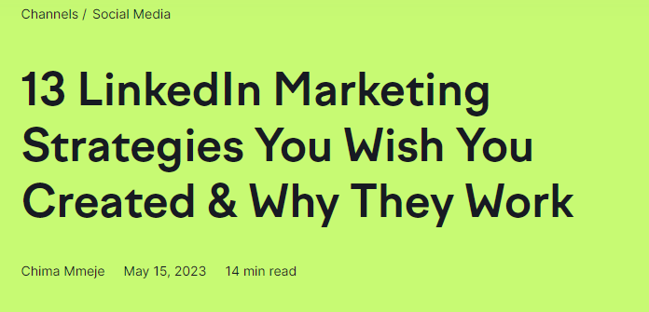
Off-Page SEO
Notes:
It’s been a while, but remember when we all went and read this article Chima wrote? Consider going back and reading it again. She uses some really strong tactics around off-page SEO here.

Slide 10
Off-Page SEO
Huge article filled with unique, valuable insights from experts
Cites a number of influencers with large social followings
Leverages available data to make her piece a hub of information for searchers
Notes:
Huge article - backlinks, social following - you can almost guarantee a number of these people will share an article that promotes them in a positive light. This works even better if you cultivate a strong social media following and relationships yourself. Just having a really comprehensive article and being the best source of information can help generate backlinks as well.

Slide 11
Other Off-Page SEO Tips
Interview and cite influencers and/or experts and cultivate those relationships
Develop a social media presence where you can share your work
Build a network with other people in your niche to share each other’s work
Consider events or creative ways to draw people to a page and get them coming back
Notes:
With one site that I worked on, a key page had taken a huge drop in search results. We did a number of events around the page: email campaigns directed at that page and a couple of events directed around that page, including a scavenger hunt that directed people back to the page every day over the course of a few weeks to gather clues and win prizes. This brought the page from page 50+ in search results for the keyword we were targeting to page 1. It took creativity! For anything you are writing, it can help to figure out who the influencers are around that topic and how/whether you can find a way to leverage them to improve your content’s reach.

Slide 12
On-Page SEO
Notes:
Now into the meat of this week. On-page SEO. I sent you all a pretty good guide around this to read through. THIS is the SEO you need to really know and understand when you build you brief and create your content.

Slide 13
On-Page SEO
The efforts you are making directly on a page to optimize that page
Notes:
A lot of this is in the writing, which is why we’re going to focus on it and talk about it here. The reading I sent had an extensive checklist for on-page SEO but, again, I’m going to focus on the elements you REALLY need to know that you will most likely have control over as a writer.

Slide 14
On-Page SEO
Keyword research
Keyword placement
Title
Headings
Meta description
Links
Content quality
URL
Notes:
Those are …. A couple others you may have control over, certainly on your own blogs, would be URL, images, freshness. But those are more likely to be controlled by the content department at the site itself so they’re more things you should be aware of.

Slide 15
Keyword Research
Understand your audience and what some of their pain points are
Start looking for keywords around those pain points
Create a brief around those keywords
Notes:
OK. I’m going to touch on keyword research again because doing that research and creating your brief is so, so important. If what you are writing about does not have an audience, you are spending your time (and possibly someone else’s money) on something people aren’t going to read. That doesn’t serve anyone. Spend time here EVERY time you write content.

Slide 16
Keyword Placement
Use keywords and synonyms for target keywords throughout your content in a natural way
Leverage “money” keyword areas and ensure your target keyword gets maximum exposure
First 100 words of the page
Title
Headings
Meta Description
Image alt text/image file name
Notes:
You’ll also note that most of these money areas of keyword placement are other key elements of on-page SEO

Slide 17
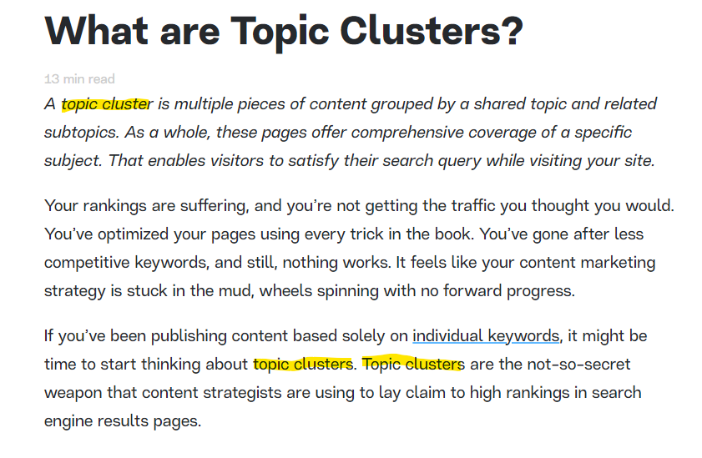
Keyword Placement - First 100 Words
Notes:
The first 100 words - your intro! Search engines are looking for keywords here because this should be the place where you tell readers what your content is about. Readers are looking for their target keyword here too. After all, if the content isn’t about the topic they are looking for, what are they doing here? This is the first organic result for “topic clusters.” It comes from the Market Muse blog. This section is 134 words long and it uses the target keyword 3 times.

Slide 18
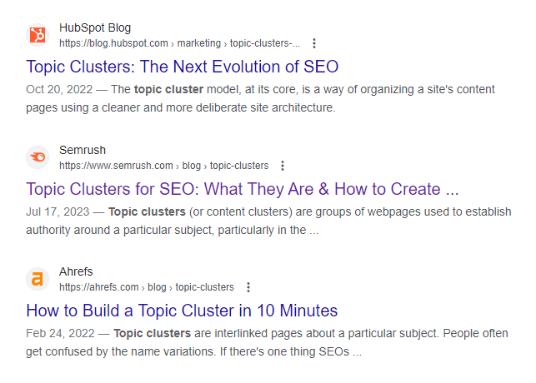
Page Title/Title Tag
Notes:
Since we’ve been working on some keyword research around topic clusters as a keyword, look at the content that ranks for this query. Notice that the target keyword is present in each and every title. That helps Google understand that this is what the page is about, but it also makes things clear to people. If I’m searching “topic clusters” those are the words my eyes will automatically scan the page for as well. Title/title tag should be about 60 characters. Note that many SEOs recommend getting the target keyword near the front of the title. I have seen some case studies where this has proven beneficial, but Google also says that the title tag plays only a minor role as a ranking signal, so I’d say do it if it works and doesn’t sound totally weird. It’s also worth noting that as of a Google update in 2021, Google actually adjusts many title tags itself to what it believes best describes the content on the page. May as well do a good job of it yourself! You also want this title to accurately portray what’s on the page - Google also looks at how people engage with the page once they land. If they just get there and say “wait, this isn’t what I thought it was going to be,” that isn’t going to be good.

Slide 19
Headings (H2, H3, H4)
Notes:
Here are the subheads of the article we just looked at on the previous slide from Market Muse. Seeing a pattern here? Clearly, we are reading about topic clusters! Keywords are crucial here. Headings are also how you tell Google about all the topics and subtopics you are covering on the page.

Slide 20
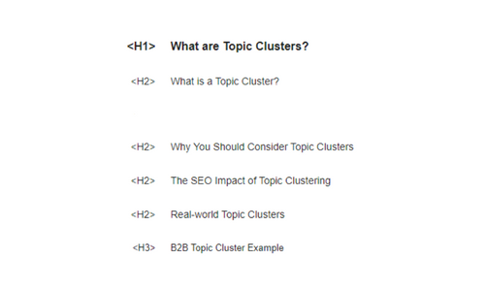
Keyword Placement - Headings (H2, H3, H4)
Notes:
Now here’s what Google sees. This is found in the code of the page, or what we call the HTML. I pulled it out easily using the SEO Pro extension. These tags show Google the hierarchy of the page. H1 is the title tag, H2 are the subheads, H3 sub-subheads. So, just like you read the page, Google is reading the page and seeing what it is about. Having keywords in your subheads, particularly H2s help Google understand that this topic is the target of your page. This is what your page is about. And you can see that Google is seeing that topic clusters keyword all the way down the page.

Slide 21
Keyword Placement - Meta Description
Notes:
You probably recognize this from search results. The highlighted text here is a meta description. It is designed to tell searchers a little more about what’s on the page, and hopefully entice them to click and check it out. I’m moving down the page one spot to focus on the SEMRush result on this search because Google isn’t showing a meta description for Market Muse as a result of some of the other features they are showing on the page. Character limit for meta descriptions in terms of what Google can show on the page is somewhere around 150-160 characters. It’s also recommended that you make this actionable - remember that this is what people are seeing in search results. The goal here is to inspire a click.

Slide 22
Keyword Placement - Meta Description
Notes:
So, Meta Descriptions are money spots that should include that juicy target keyword. But just something to note … Google likes to monkey with these too. On the top you can see the meta description that appears in the HTML code and on the bottom, you see the adjusted one Google created. Even if Google throws out your meta description entirely, though, it still sees it - and that keyword. Plus, again, for people looking at the search results, seeing that keyword helps them recognize that the content is going to answer their query.

Slide 23
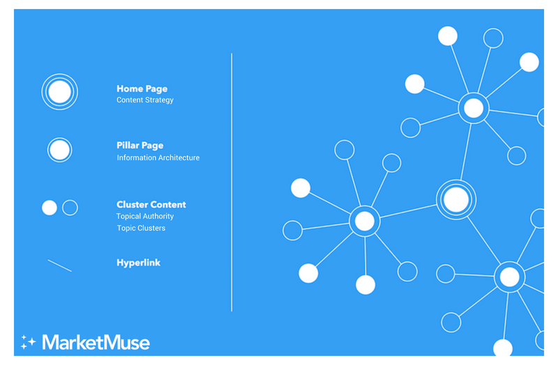
Image Alt Text/File Name
Notes:
So if you’re writing for someone, it’s unlikely this will be your job but if you are building your own blog, this one’s good to know. So, Alt text is text that you add to an image that basically tells Google what this image is. Blind people using a screenreader also use this to get a sense of what the images on the page are about. Content management systems have a field for you to fill in for this when you add an image to a post. The file name is literally the name you give that image when you save it to your computer. This is the name that will show in the code when you upload the image to your content management system. So here, you can see an image pulled from the the Market Muse blog on Topic Clusters and below that, the Alt text and file name for that. Keywords! You also just want the alt text to accurate describe what the picture is (think of that screenreader) and the file name to do the same.

Slide 24
Content Quality
Meets the reader’s needs (know your audience)
Shows expertise
Is easy and enjoyable to read
Provides unique information or insight
Notes:
OK, so, here’s the big one in on-page SEO. Because you can add all the keywords you want but if the content sucks, it probably isn’t going anywhere.

Slide 25
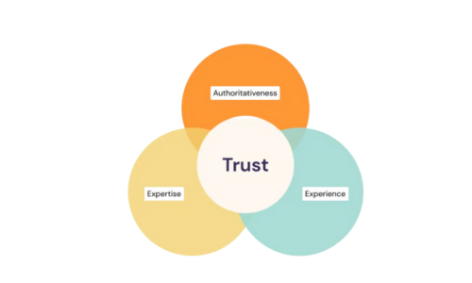
Content Quality
Notes:
This chart comes from Google and it gives us a sense of how the algorithm assesses content quality, both on a page level and a site wide level. We’ll run through these quickly, as considering them when you’re writing is really important.

Slide 26
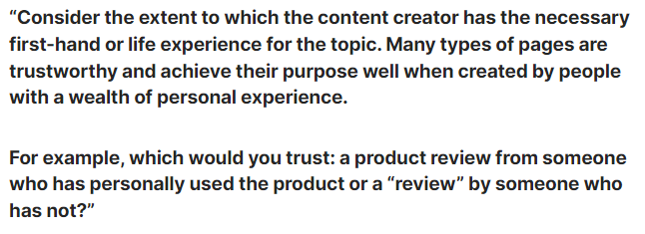
E-E-A-T - Experience
Notes:
First-hand experience can be an important component in content, but I would argue that it doesn’t always have to come from the creator - although with product reviews, it certainly should. More content created by someone with experience is performing better these days, but a lot of content that references people with experience and refers to first-hand experience is also doing well. This comes from Google’s Quality Rater guidelines. Quality raters are people Google works with to assess website quality and it uses those assessments to determine whether the algorithm is assessing content quality like a person would. Essentially, they want the algorithm to see a site like a person would.

Slide 27
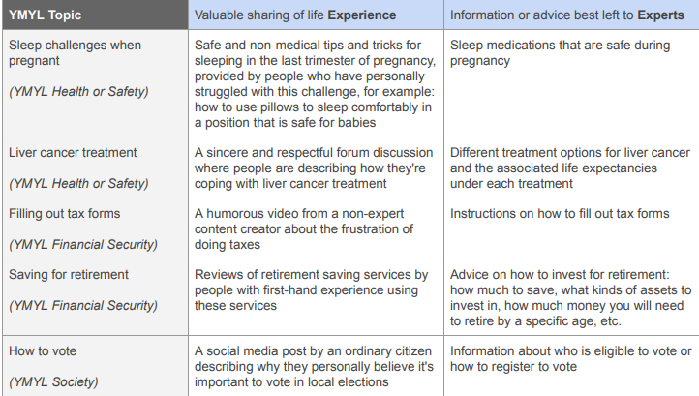
E-E-A-T - Expertise
Notes:
Experience is similar to expertise, but in some cases, one is better than the other. This can help you decide what kinds of sources you want in your content too. Are you better finding people who have first hand experience, experts, or both? We’ll talk a bit about how to find sources and experts - I think I’ll make a whole class on that. But you do want to look for the best expertise you can find for what you are writing

Slide 28
E-E-A-T - Authoritativeness
Does the site have a reputation for providing quality information?
Does the site have a reputation for providing quality information on this topic?
Does the writer have a reputation for writing on this topic?
Does the page link to other high-quality sources
Notes:
OK, so these aren’t all things you have control over, but some of them are things you can work on. So, a piece of content about topic clusters has a better chance of ranking if it’s posted on a site that’s recognized for writing lots of high-quality content about content marketing and SEO. It would be even better if the author was a well-known SEO or writer who often covers SEO. Finally, any good content should link to high-quality sources, like original research, and content from other sites and authors with high authority. As an author, you can work to build up your own EEAT by continuing to publish in the areas where you want to focus and working to publish on higher quality sites.

Slide 29
E-E-A-T - Trust
Is the page accurate, honest, safe and reliable?
Notes:
You’ll note from a previous slide that all those elements of EEAT overlap with Trust in the middle. All of them are key to establishing trust. What that means, depends on the content itself. If you’re just writing a post that is designed to make people laugh, it may just have to be very funny and shareable. If you’re giving out health or financial or business advice, the bar will be much higher.

Slide 30
Questions?

Slide 31
Homework
Let’s say you are starting your own blog to promote yourself in the niche in which you’d like to be writing
Come up with your first blog post so:
Define your target audience and figure out who they are
Do your keyword research and create a brief
Write the post
Notes:
Give the next 3 weeks to work on this. I’ll follow up with you every week. I would recommend starting right away so that when we have 1 on 1 next week, I can help you a bit. Then we’ll work on continuing to refine that blog post in the following weeks.

