Slide 1
Content Writing
How to write content with impact

Slide 2
How This Course Will Work
15 weeks, new topic each week
We’ll review the previous week and homework, answer remaining questions and start a new topic.
At the end of each session, I’ll let you know what’s up next week and share an outline of what will be covered.
Week 7 will be set aside for a 1:1 meeting with each of you.
You can reach out to me by email anytime between classes for help.
For week 15, I will provide a final assessment/assignment.
I want your feedback - this course is for YOU.
Notes:
Share an outline in Google docs folder so you can give it some thought before we meet - I’ll plan to do that on Mondays
Week 7 will be set aside for 1:1s but if you’re struggling and need one before that, please ask!
We will do a final assessment/assignment at the end of the course but please don’t stress about it. This isn’t a pass/fail course - it’s about growing your skills as a professional.
Reach out to me anytime - I prefer email. Let’s use the Slack channel for group discussions - that is so valuable for learning
Send me feedback anytime, both positive and negative (I can take it).

Slide 3
Course Guidelines
Please log in for the course on a laptop or desktop computer if at all possible.
If you have questions while I’m going through the slides, please enter them in the chat.
Let’s keep this an open, supportive space for everyone to learn and encourage each other.
Notes:
You should have received these by email before we started the course, but let’s go over them again. Adhering to these points will help you and your classmates get the most from the course - as well as people who will have access to these videos later.
Chima has asked that you don’t interrupt for questions during the presentation. This will make it easier for others to watch later. If you have questions, put them in the chat and I’ll answer as many as I can at the end. You can also send questions by email along the way. But please ask - questions are important for learning. It also helps me - it’s hard to be the only one talking for an hour!!

Slide 4
About Me
Been working in online content since 2005
Investopedia
Freelance writing
Janalta
I have two kids
I love running, rock climbing, reading, cooking
Working on improving my skills/knowledge around technical SEO
Notes:
Since we’ll be spending a few months together, here’s a bit about me.
Janalta, build sites in various niche areas, using SEO to drive traffic and build a business around them

Slide 5
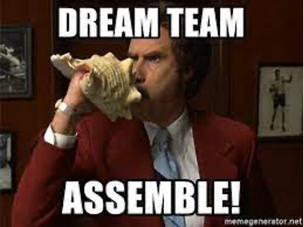
About You
Where are you from?
Why are you here?
What is your No.1 challenge?
Notes:
Some insights from the survey

Slide 6
How to Become a Better … Reader
Notes:
Improving your writing takes work, practice and time
You need to write, but you also need to read
The reading is something you can start RIGHT NOW to help start improving the way you see writing, both yours and other people’s
If you want to be great at what you do, you have to stay in the know. Especially now with the way online writing is changing.
It’ll also help you figure out some of the areas you’re weaker in so you can learn more.
For me, it also helps keeping me feeling fresh and motivated in my work. In the survey I sent out, many of you said motivation and continuous improvement were key goals for you!
I’ll show you how to start reading like a writer and how to set up a reading list to keep you motivated and informed.

Slide 7
Reading: The First Step to Becoming a Better Reader
Start noticing how what you read impacts you
Become aware of the formats, style and structure of the content you read
Get to know the style, tone and formats of the publications you write for
Finally, start looking at content from an editor’s perspective
Notes:
When you read something that really grabs you, what’s happening there? How did the writer do that? When you read something that makes you want to sign up for something, or buy something or take some action, why is that? These are skills good writers learn and, while everyone has their own way of doing this, you can learn a lot by taking notice of other writers. You can do this whether you have the kinds of writing jobs you want or not. You can do it whether you are able to write for a living or not. You can do this as little or as much as you can make time for.
When you get good at this, you’ll be reading more like the editor of the publication where you want to be working or freelancing. After all, this is the person who will likely be hiring you, and who you’ll want to impress
The way people write - and read - has changed a lot over the years. Now that we do a lot of reading online, paragraphs have become shorter; in some cases, formal introductions disappear so that readers can get right to the answer to their question. Notice these things when you’re reading.
Maybe you’re a reader already and read all kinds of content. That’s good. But the next step is to read content that’s relevant to the kinds of content you want to write. Want to be a tech writer? Start reading the sorts of websites you want to be published on. Start following those writers and learning more about how they do what they do. Overall, start understanding the language of that kind of content.

Slide 8
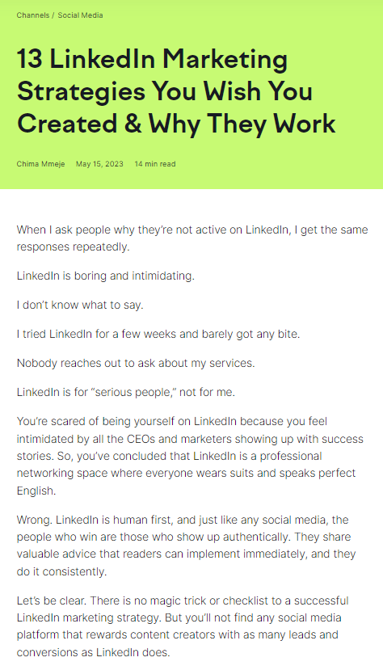
Example Article
Notes:
In looking around for an example article to use for this, I decided to use one from Chima. First, she’s a very good writer. And I think she’s also one with a career trajectory a lot of you aspire to.
I’ll put the link to this in the chat: https://www.semrush.com/blog/linkedin-marketing/. You can read this like you want to know about LinkedIn Marketing Strategies - there’s some great advice in there. But then, you can go back and consider what works about this article. There is so much terrible, boring content on the internet. This article had me interested right away. How about you? Give it a read and we’ll discuss it in the next class.

Slide 9
Thinking Like an Editor
What Editors Want
Content that fits in with what they publish
Content that won’t require too much effort to publish
Writers who “get it” in terms of what the publication needs/wants
High quality, original content
What Editors Often Get
Content that misses the mark in terms of style, tone or target audience
Content that is unpolished, unformatted
Writers who don’t take the time to drill down and understand the publication’s need
Content that is similar to a lot of other content on the same topic
Notes:
Editors, like everyone, want to streamline their work and avoid unnecessary hassles. You can help them by reading a lot of the content they’ve published before submitting to really understand what they like, how content should look and who is reading it
Editors are there to make writers’ work better, but writers need to hold up their end and present something that’s as polished as they can get it. Proofread your work. Format it and structure it in a way that’s similar to what a publication is already publishing.
We’ll dig deeper into what high quality, original content really means these days in another slide. But now more than ever, writers need to have a sharp eye on how to make something unique and valuable for a publication.

Slide 10
You can’t just read, though.
Notes:
There is so much material out there. In order to read in a way that will improve your writing and move you career forward, the key is to read intentionally. So, I’ll give you some ideas about how you can set that up for yourself and I’ll show you how I do that.

Slide 11
First: What to Read (and Why?)
Publications/companies you aspire to write for
Writers you aspire to be more like
Leading writers, editors and leaders in in the areas in which you’d like to be publishing
Notes:
Most writers will say reading is good, reading a lot of is good, anything is better than nothing. But if you want to make money writing in a certain area or style, you should really be focusing on reading the kind of writing you want to produce. What you read is up to you, but here are some suggestions on where to start.

Slide 12
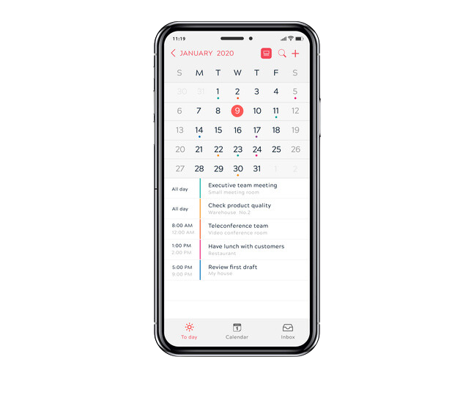
Next: Set up a reading schedule
If you want reading to help your writing and career growth, you have to be intentional about it and you have to make it a habit.
Notes:
I set aside time every Sunday afternoon for this. I’ll also do some reading if I have some extra time where I’m waiting around, like for an appointment.

Slide 13
“Habits are the compound interest of self-improvement.”
Atomic Habits, James Clear
Notes:
A lot of people have read this book and the message is really simple: the habits you set dictate your success and the trajectory of your life. And it’s really true. You won’t find a person at the top of their field who doesn’t have habits and systems set up to help them achieve that success. In this case, I’m arguing that if you want to write better, you have to make a commitment to staying on top of what’s happening in your field. And if you don’t set up a system to ensure this happens on an ongoing basis, it’ll probably fall off your plate within a few weeks.
So, in addition to setting some time aside in your schedule to do this, how does this actually work?

Slide 14
Make a reading list.
Notes:
Set yourself up for success. Make a reading list. It’s as simple as that. The cool thing is, there are some good options to help you do that in a really handy and accessible way.
As you read, you’ll be discovering moves you need to make to move forward your career. As we move through the course, it’ll also help you identify areas of weakness I may be able to help you with.

Slide 15
What You Might Have On Your Reading List
Websites and blogs
Social media accounts
Webinars, courses, etc.
Notes:
Websites and blogs that you write for, would like to write for or that are in the niche you want to write for. A couple of you said you wanted to write for SaaS companies. Some of the big ones that do great content marketing there are Hubspot, Moz, Zendesk. Maybe you want to follow them. Or, maybe there are some smaller companies you’re interested in or that are posting jobs. The point its, READ THEM. Get to know how they do content and what works for them.
Social media accounts of writers, editors and other leaders in your areas of interest (content marketing, conversion marketing, technology writing, product reviews etc.). So look at the sites you picked above. Who is writing for them? Who is editing or managing their content? Are those people sharing on social media? Are they sharing about their strategies, wins, losses. You can learn so much here!
As you start reading, you are really going to start to become familiar with your weaknesses. Like, “oh, everyone here is talking about topic clusters. I don’t even know what that means.” So, if you want to learn about topic clusters, you can go out and find sites that are talking about that, videos, courses, etc. and add that to your to-do list.

Slide 16
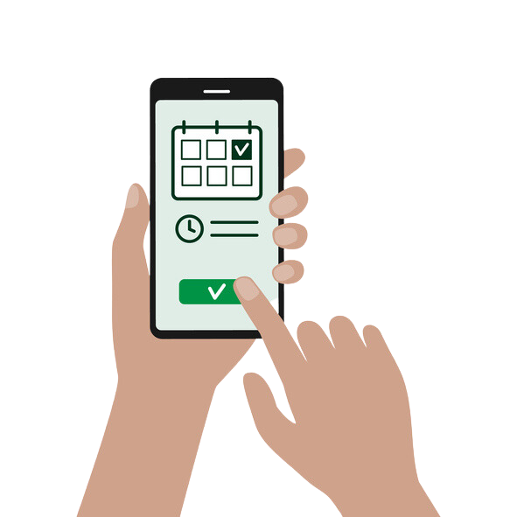
Getting Organized
Set a time and place to read each week
Set up a system for storing your materials
Notes:
So, in order to make this reading list thing work, you need two things. The time and place is easy. Pick a time that is likely to be open for you every week and put it in your calendar just like an appointment. (You should do this for absolutely any task that is important to you in your life, by the way.)

Slide 17
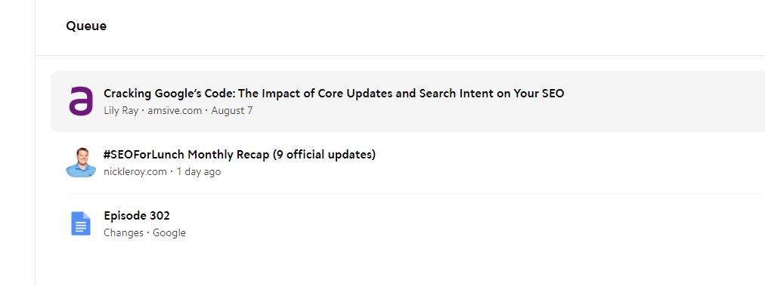
Websites and Blogs
Google bookmarks
Matter app
Pocket app
Notes:
When you come across an article you want to read, you may not have time to read it right then. Save it for your dedicated reading time. Here are some free options for how you can do that. I’ll send links after the course in case you want to set these up. I use Matter. It lets you save your list, listen to it in audio, organize your reading with tags.
This is where the calendar comes in handy. Let’s say you’re working on a piece and you find an article you want to read. But … you should be finishing what you’re working on. Save that piece for your reading time.

Slide 18
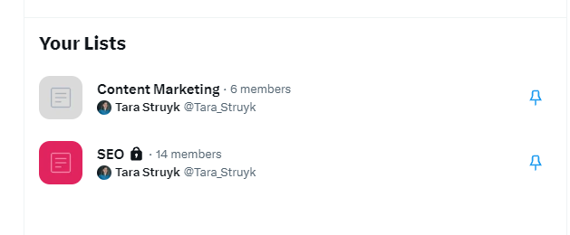
Social Media
Build lists on Twitter (er … “X”)
Follow people on LinkedIn, save relevant posts for later
Join relevant Subreddits and save threads (you can save these links on some reading apps as well)
Notes:
Sometimes social media can be a time suck. You can get into what’s called the “scroll hole”. But if you set yourself up, it can also be really productive and motivating.
If you build out lists, rather than scroll through friends’ posts, memes etc., you can use your dedicated reading time to scroll through relevant people you follow and read their content.
I don’t know of a way to segment followers on the free version of LinkedIn, but you can save posts for later

Slide 19
Questions?
Notes:
OK. Now is the time for questions. Does anyone have questions?

Slide 20
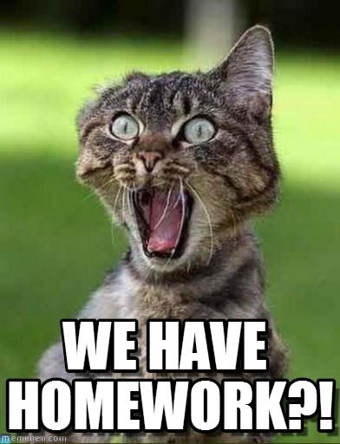
Homework
Set up your reading list and schedule your reading
Read Chima’s article
Notes:
We’re going to have homework every week, but this week’s homework will be pretty easy and fun. This week I want you to set up your reading list and schedule your reading time. I’ll send you the links for all the services I suggested but feel free to find anything else that works for you. Next week we’ll take a few minutes at the beginning of the class and everyone can share some of the sites/people they are following and the systems they are using. I’ll continue to follow up with you on this throughout the course. Also read Chima’s article and come prepared next class with three things that stand out to you about it. (Remember to read it like an editor!)

